Slide 1
COMP 7212: Operating/Distributed Systems
Chapter 1: Introduction
Slides created by
Dr. Myounggyu Won
Reference: Distributed Systems: Principles and Paradigms (3rd Edition)

Slide 2
Outline
What is a distributed system?
  Characteristic 1: Collection of autonomous computing elements
  Characteristic 2: Single coherent system
  Middleware and distributed systems
Design goals
  Supporting resource sharing
  Making distribution transparent
  Being open
  Being scalable
Types of distributed systems
  High performance distributed computing
  Distributed information systems
  Pervasive systems

Slide 3
What is a distributed system?

Slide 4
What is a distributed system?
Definition
  A distributed system is a collection of autonomous computing elements that appears to its users as a single coherent system.
Autonomous computing elements?
  Components within a distributed system that can operate independently of other parts.
    Make decisions based on their local data without needing central control or intervention
    Crucial for designing robust, scalable, and efficient architectures

Slide 5
What is a distributed system?
Two characteristic features
  A collection of autonomous computing elements (nodes) that behave independently
    Node: either a hardware device or a software process
  Users believe they are dealing with a single system
    Implies collaboration between nodes
      How to establish collaboration is the key for distributed systems

Slide 6
Characteristic 1: Collection of Autonomous Computing Elements (1/3)
A distributed system consists of various kinds of nodes (e.g., ranging from very high-performance computers to small hand-held devices)
Nodes
  High-performance computing systems, smartphones, embedded systems, etc.
  A fundamental principle is that nodes act independently each other
  But they collaborate toward a common goal via exchange of messages
  Each node has its own notion of time (i.e., cannot assume that there is always a global clock)
    Requires time synchronization (Chapter 6)

Slide 7
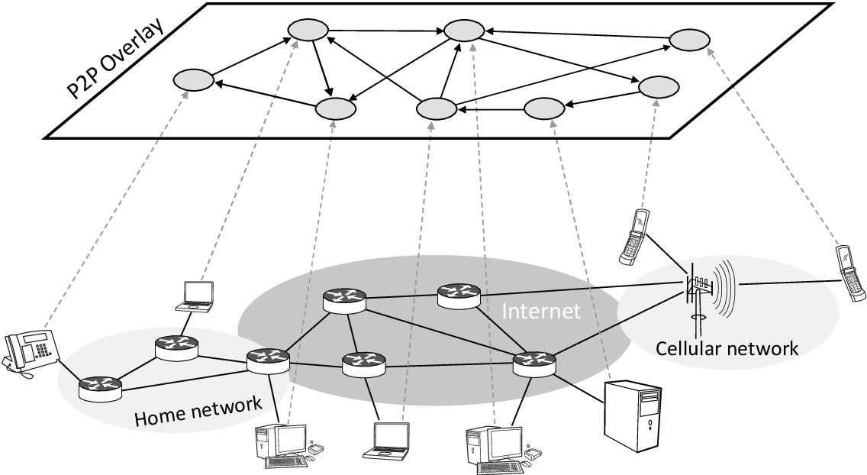
Characteristic 1: Collection of Autonomous Computing Elements (2/3)
Nodes are programmed to achieve the same goal.
  We need to manage the membership and organization of nodes.
Nodes are often organized as an overlay network
  A network of “connected” nodes
Overlay Network:
- A virtual network built on top of a
physical network
- Represents a logical connection
between nodes.
Physical Network:
- A network of actual hardware

Slide 8
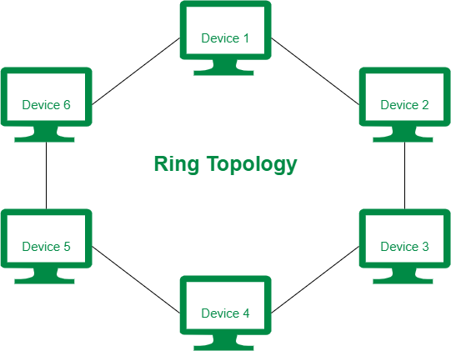
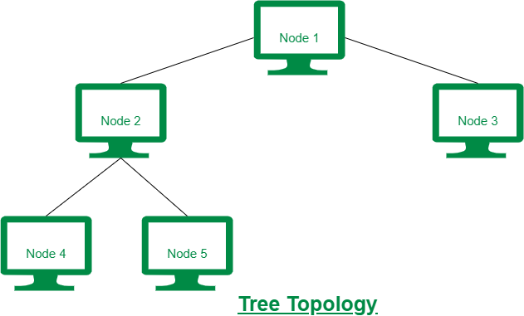
Characteristic 1: Collection of Autonomous Computing Elements (3/3)
  Two types of overlay networks
    Structured overlay: well-defined neighboring nodes with whom it can communicate (e.g., tree or ring)
    Unstructured overlay: randomly selected neighboring nodes (e.g., mobile network)

Slide 9
Characteristic 2:
Single Coherent System
Users do not notice that they are interacting with multiple nodes dispersed over a network.
Distribution transparency
  An important design goal of a distributed system
  It does not matter on which node a process is running and data is stored.

Slide 10
Middleware and Distributed Systems (1/3)
A distributed system consists of heterogeneous nodes.
  e.g., different operating systems, different hardware, different interfaces, etc.
To assist development of a distributed system with heterogenous nodes, there is a separate layer on top of an operating system – this is called the middleware (distributed-system layer).
  Hides the differences of different hardware and OS
  Exposes a common interface

Slide 11
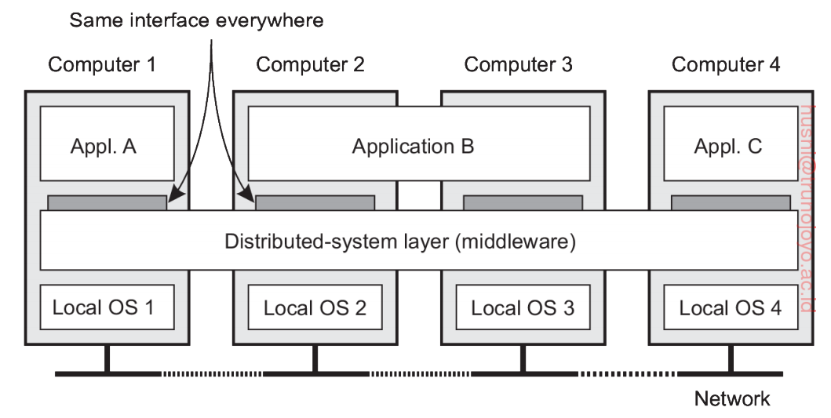
Middleware and Distributed Systems (2/3)
App B is distributed across two computers/nodes
Provides
means for
apps to
communicate
Hides the
differences
in hardware
and OS

Slide 12
Middleware and Distributed Systems (3/3)
Middleware services
  Inter-application communication
    Communication between applications with different interfaces
  Security services
    Secure access to distributed system components
  Accounting services
    User management
  Recovery from failures

Slide 13
Design Goals
Four goals to meet to make building a distributed system worth the effort.

Slide 14
Supporting Resource Sharing
Resources: data, files, services, hardware, etc.
Why share resources
  Cheaper to have a single resource
  Easier collaboration and data exchange among nodes by allowing them to share resources
    e.g., the Internet, peer-to-peer networks like BitTorrent
Make it easy for users to access and share resources

Slide 15
Making Distribution Transparent (1/2)
Hide the fact that processes/resources are dispersed across multiple computers
  Processes and resources are invisible to end users and applications
  End users and applications are only aware of the interface that the distributed system exposes.

Slide 16
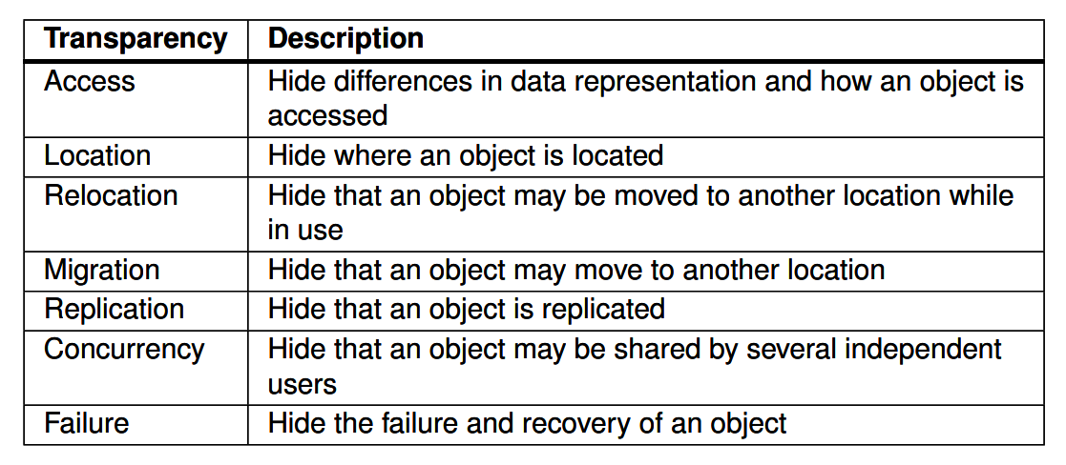
Making Distribution Transparent (2/2)
  Types of distribution transparency
    Here, the term object means a process or a resource

Slide 17
Being Open
Should be easy to use and can be easily integrated with other systems by achieving the following.
  Interoperability: two different implementations of systems/components can co-exist and work together by following a common standard.
  Portability: a system/component can be executed, without modification, on a different system/component.
  Extensibility: it should be easy to add new components to a distributed system or replace existing ones.

Slide 18
Being Scalable
The size of a distributed system should be easily extended.
Scalability in three different dimensions.
  Size scalability: easily add more users and resources without any noticeable loss of performance
  Geographical scalability: users and resources may lie geographically far apart
  Administrative scalability: easily manageable even if the distributed system spans many independent administrative domains.
    Challenges are conflicting policies w.r.t. resource usage, management, and security

Slide 19
Scaling Techniques (1/3)
How do we achieve scalability?
(1) by hiding communication latencies
  Applicable for geographical scalability
    Even if two nodes lie far apart, by hiding the communication latency, the user does not know whether the two nodes actually lie far apart.
  How to hide the latency: Asynchronous communication (does not wait for a reply) -> can do other useful work while waiting for a reply message
    How about interactive applications (must receive a reply within a time bound, i.e., the asynchronous communication is not an appropriate solution)?
      Reduce communication, e.g., move part of computation from server to client

Slide 20
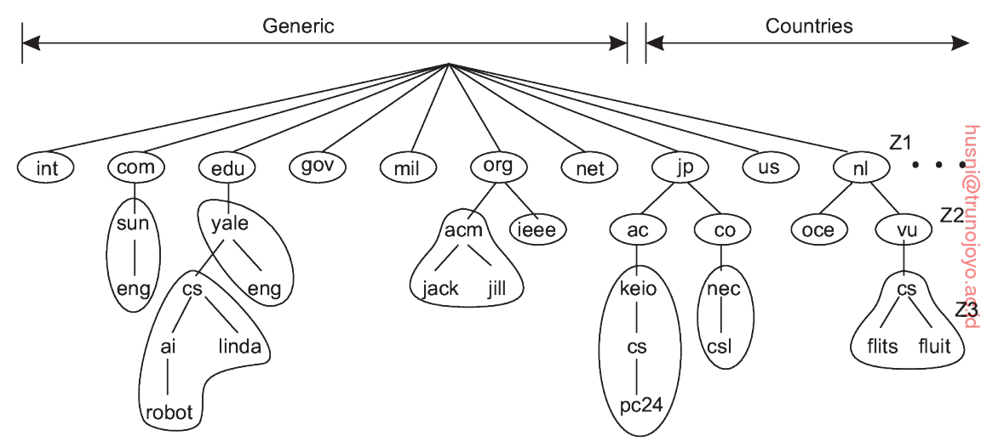
Scaling Techniques (2/3)
(2) by partitioning and distribution
  Splitting a component (or a task) into smaller pieces and distributing it across the system/network so that no one node is burdened with too much task.
    e.g., Domain name system (DNS) (URL -> IP address)
The domain name space is hierarchically organized into a tree of domains. Some of
the nodes are grouped as a non-overlapping zone.
Instead of making a single system to manage all the domain names, we divide the
component into smaller pieces and different servers manage a
certain portion of domain names.

Slide 21
Scaling Techniques (3/3)
(3) by replication
  Increases performance of a large-scale system by balancing the load on replicated systems.
  May address the latency issue by placing a replicated system nearby.
  Drawback (consistency problem)
    Modifying one copy makes the copy different from the others.
    Global synchronization mechanism

Slide 22
Types of Distributed Systems
Before we discuss the principles of distributed systems, let us first take
a closer look at the various types of distributed systems

Slide 23
High Performance Distributed Systems
A distributed system for high-performance computing tasks
  Cluster computing
    Similar workstations/PCs connected via high-speed LAN
    Each node runs the same OS (in most cases)
  Grid computing
    Similar to cluster computing
    Constructed as federation of computer systems (i.e., each system falls under different administrative domain)
      e.g., Internet: Different universities, companies, governments, and Internet service providers manage their own networks, but all of those networks communicate using common protocols.
    Different hardware, software, network technology
  Cloud computing
    Similar to grid computing, but focused on providing virtualized interface to users

Slide 24
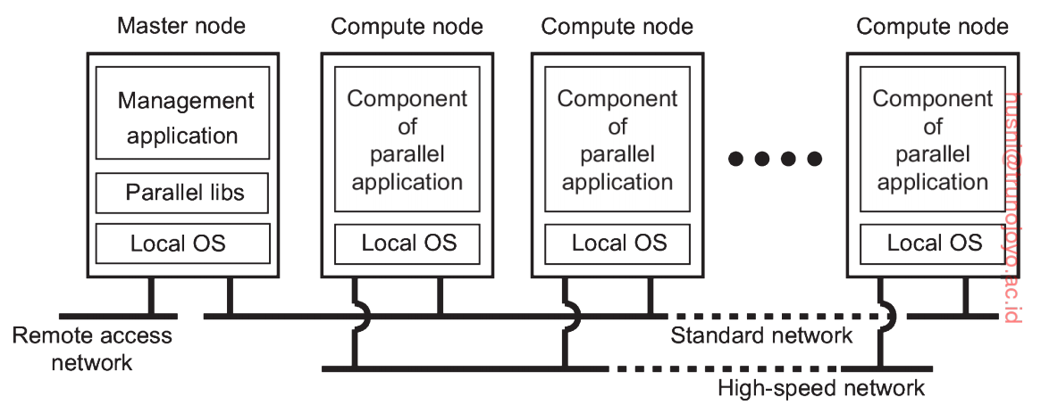
Cluster Computing Systems
Cluster computing
  A collection of computers connected in a high-speed network
  Mostly used for parallel programming (i.e., running a single computation intensive task in parallel on multiple machines)
  Each cluster consists of a collection of compute nodes and accessed by means of a single master node.
    Master node -> allocation of jobs to nodes, maintenance of a batch queue of jobs submitted, provision of interface to users
    \
Manage and control
the compute nodes
Used for transmitting computation-related data

Slide 25
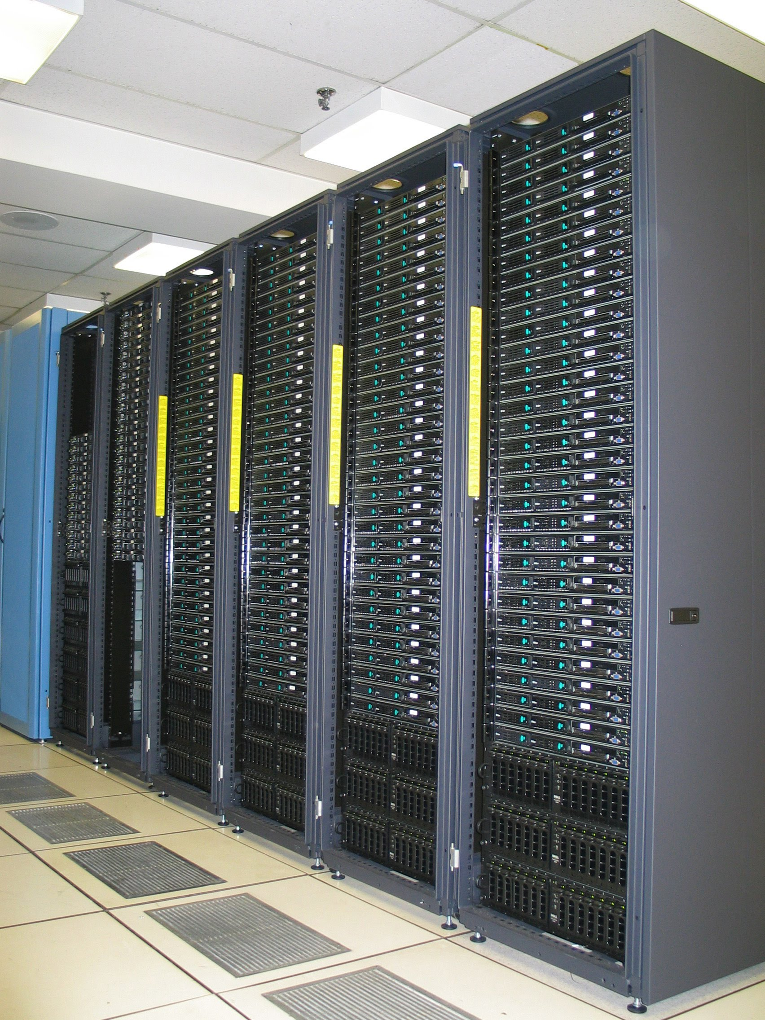
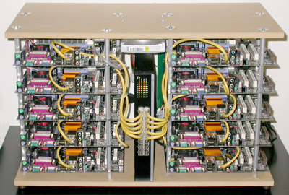
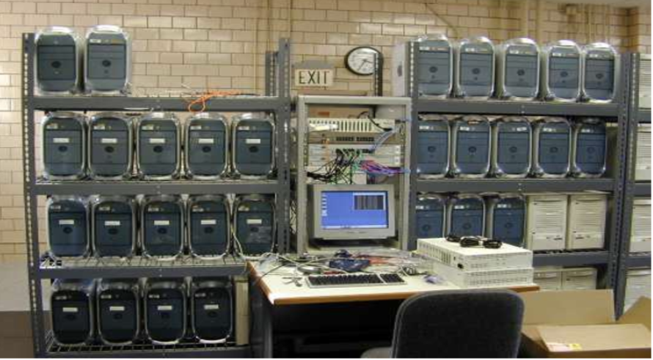

Slide 26
More on Cluster Computing
Advantages
  High Performance
    The systems offer better and enhanced performance than that of mainframe computer networks.
  Easy to manage
    Cluster Computing is manageable and easy to implement.
      Highly organized and controlled by the master node
  Scalable
    Computer clusters can be expanded easily by adding additional computers to the network.
  Availability
    The other nodes will be active when one node gets failed and will function as a proxy for the failed node. This makes sure for enhanced availability.
  Flexibility
    It can be upgraded to the superior specification or additional nodes with different hardware/software specifications can be added.

Slide 27
More on Cluster Computing
Disadvantages
  High cost
    Requires extra hardware and software efforts to build the system.
  Problem in finding fault
    It is difficult to find which component has a fault.
      All nodes are tightly coordinated and work together
      A failure of one node may degrade the overall performance
  More space is needed
    Infrastructure may increase as more nodes are needed to manage and monitor.

Slide 28
More on Cluster Computing
Applications of Cluster Computing
  Various complex computational problems can be solved.
    Data mining.
    Weather forecasting.
    Image Rendering.
    Various e-commerce applications.
    Earthquake Simulation.
    Petroleum reservoir simulation.

Slide 29
Grid Computing Systems
Grid computing systems
  Similar to cluster computing systems
  A federation of systems
    Compared to cluster computing, no assumptions on similarity of hardware, OS, networks, admin domains, security policies, etc.
      Resources/nodes are spread over different geographical locations with different administrative policies.
Benefits compared to cluster computing
  Flexibility
    Grid computing is not constrained to a specific building or location. You can set up a grid computing network that spans several regions. This allows researchers in different countries to work collaboratively with the same supercomputing power.

Slide 30
More on Grid Computing
Features of grid computing
  Large scale: Resources for grid computing are dispersed over numerous places and are connected through a network.
  Heterogeneity: Grid machines are heterogeneous in nature
  Loosely coupled: Changes in one component least affect existence or performance of another component
  Resource sharing: The grid allows organizations to share resources among grid machines.
    CPU, memory, storage, etc.
  Multiple administrations: Administrators can control resources in the grid machine based on their own administrative policy.
  Resource coordination: Resources are not just randomly shared. Nodes communicate to determine how the resources are best utilized.
  Quality of Service (QoS): Grid uses many machine resources to give customers high-quality services at the desired degree of performance.
  Transparent access: Despite the grid’s complexity, clients can only perceive it as a single virtual computer operating.

Slide 31
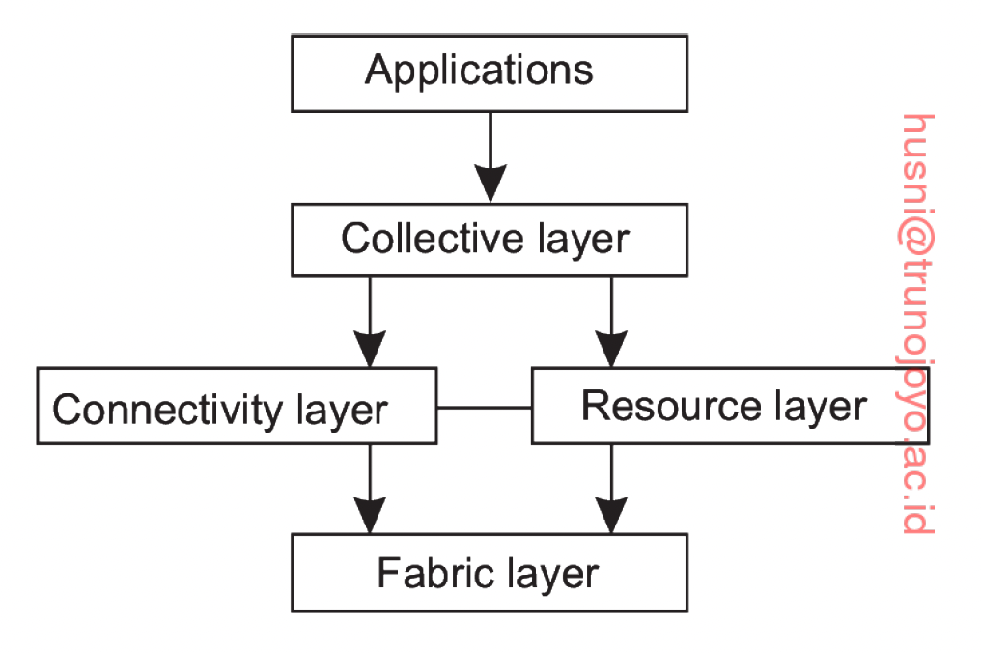
More on Grid Computing
  Architecture (Foster et al. [2001])
    The architecture of grid computing systems consists of four layers.
      Fabric layer: provides interfaces to local resources at a specific site
      Connectivity layer: consists of communication protocols (e.g., protocols for data transfer)
      Resource layer: responsible for managing a resource
      Collective layer: deals with handling access to multiple resource, i.e., provides various resource-related services (e.g., resource discovery, allocation and scheduling of tasks)

Slide 32
Cloud Computing Systems
Cloud computing
  Similar to grid computing, but it opens up resources in a grid computing system to customers
  Easily usable and accessible pool of virtualized resources is provided to customers
    Instead of proving actual hardware, an interface is provided to users to utilize the resources
  Organized into four layers
    Hardware (actual machines and network devices, e.g., processors, routers, etc.)
    Infrastructure: backbone for cloud computing systems to make the hardware available to customers; deploys virtualization techniques to provide customers virtual storage, virtual computing resources, etc.
    Platform: provides environments for customers to develop and deploy applications that run in a cloud
    Application: actual software used by customers

Slide 33
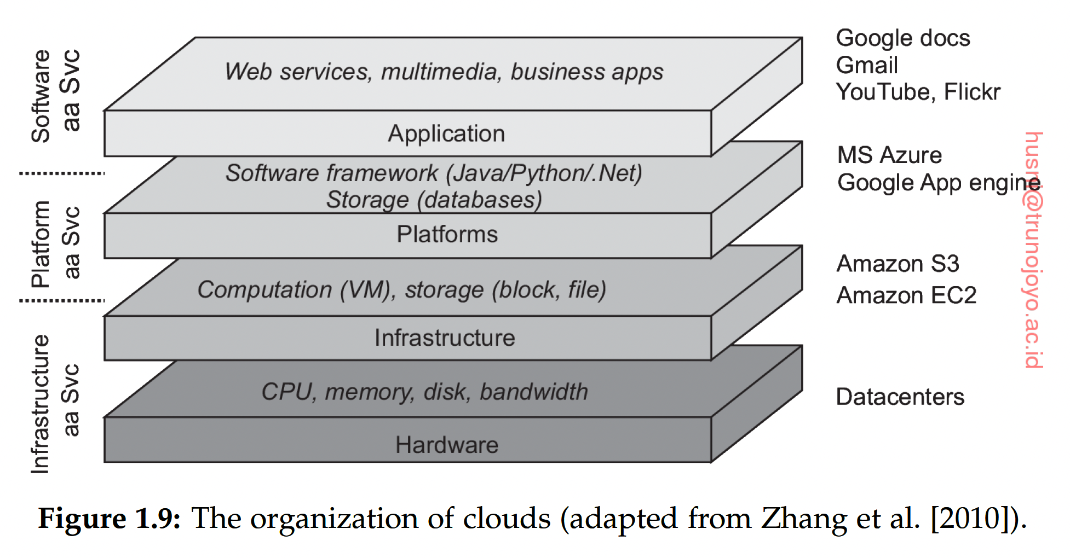
Turns hardware into
usable virtualized
resources
(Virtual computing)
(Virtual Storage)

Slide 34
Distributed Information Systems (1/2)
A distributed system for
  Distributing processing and/or data across heterogeneous servers via multiple communication models
    Example: Online shopping mall
    Processing is divided among multiple servers (e.g., Web Server, Payment Server, Inventory Server)
    Data is stored in different places (e.g., Customer DB, Inventory DB, Billing DB)
  Two important characteristics
    Distributed transaction processing
      Operations are performed in the form of a transaction
      A transaction is a group of operations that should be treated as one logical unit of work.
    Enterprise application integration
      connecting different business applications so they can exchange information and work together.
        E.g., customer-management software, payroll software, inventory software, accounting software, shipping software.
        the applications exchange information automatically.

Slide 35
Distributed Information Systems (2/3)
Distributed transaction processing for efficient data access/manipulation
    Operations on a resource are carried out in the form of transactions
      e.g., BEGIN_TRANSACTION and END_TRANSACTION are used to delimit the scope of a transaction; operations between them form the body of the transaction
    Why transactions: to achieve ACID properties of transactions
      Atomic: Either the entire transaction happens, or none of it happens.
      Consistent: data access/manipulation does not violate system invariants
      Isolated: data access/manipulation does not interfere with each other
      Durable: Once a transaction commits, the changes are permanent

Slide 36
Distributed Information Systems (3/3)
Enterprise application integration
  A framework that enables different applications within a business environment to communicate and work together seamlessly.
  Integration methods
    Middleware
      Enable applications to communicate without modifying their code
    APIs
      Sets of rules and specifications that apps can follow to communicate with each other
    Message Brokers
      Tools that ensure the delivery of messages between heterogeneous applications.

Slide 37
Pervasive Systems
The distributed systems discussed so far are characterized by stability (i.e., nodes are fixed; permanent high-speed network)
Pervasive systems
  Consists of mobile and embedded computing devices
  Separation between users and system components are blurred
    No actual users; instead, there are sensors and actuators.

Slide 38
Examples of Pervasive Systems
Smart home systems
Wearable technologies
Healthcare monitoring systems
Smart cities
Environmental monitoring systems

